Slide 1
CHIPS ACT: Basic research needs report to DOE Summary report from FES workshop held August 8-9, 2022 Chair: David Graves, Princeton University Co-Chairs: Catherine Labelle, Intel Corp., Mark Kushner, U. Michigan FES Contact: Nirmol Podder, US-DOE Section Authors: Steven Shannon (NCSU), Eray Aydili (NYU), Jane Chang (UCLA), Shahid Rauf (Applied Materials), Vincent Donnelly (U. Houston), Mark Kushner (U. Michigan), David Ruzic (U. Illinois), Peter Meyer (ASML), Lawrence Overzet (UT-Dallas) Thank you to the 24 in person attendees and 27 virtual attendees who participated in the workshop and contributed to this report!

Slide 2
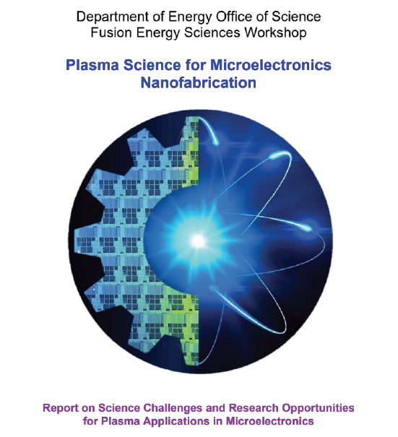
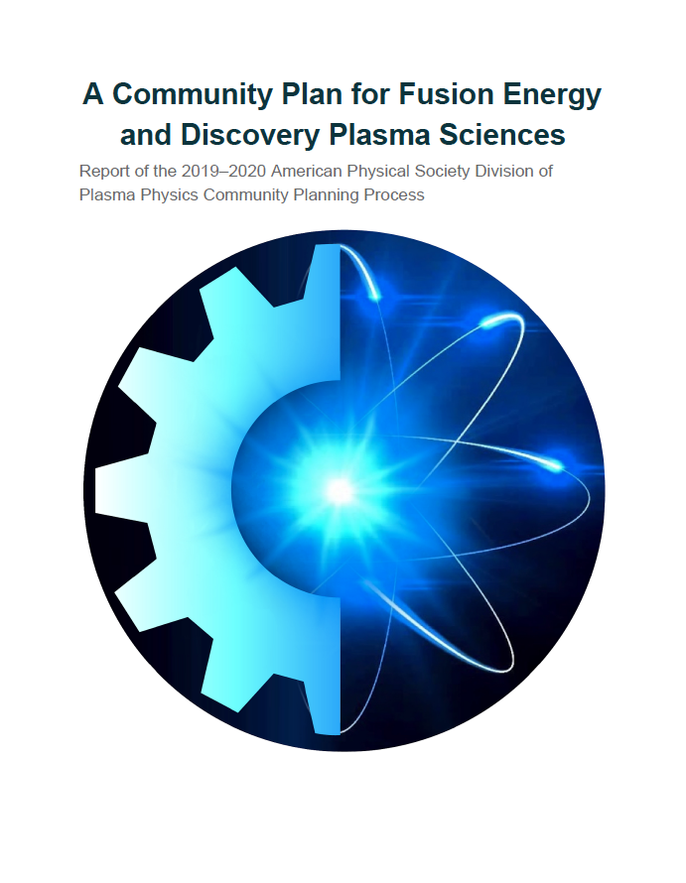
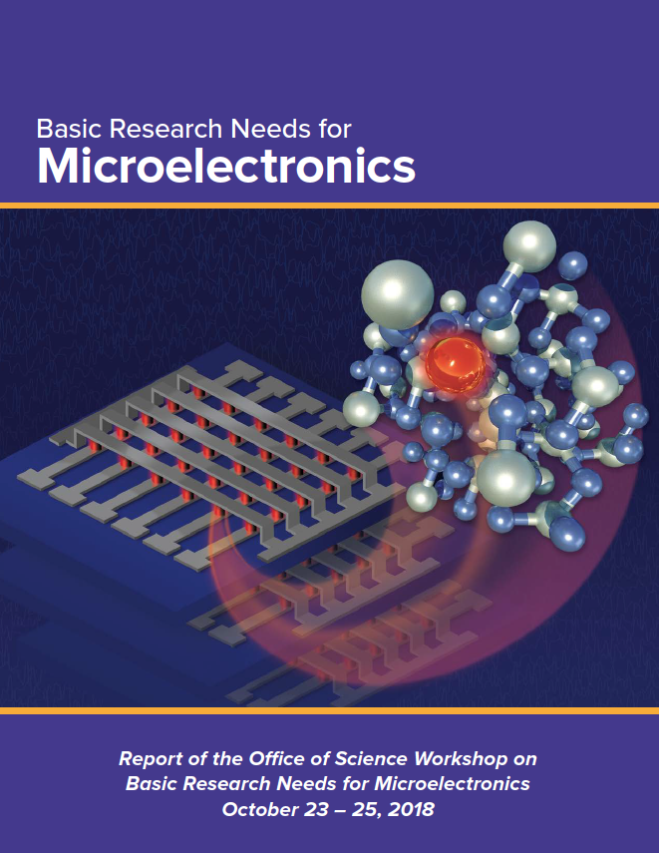
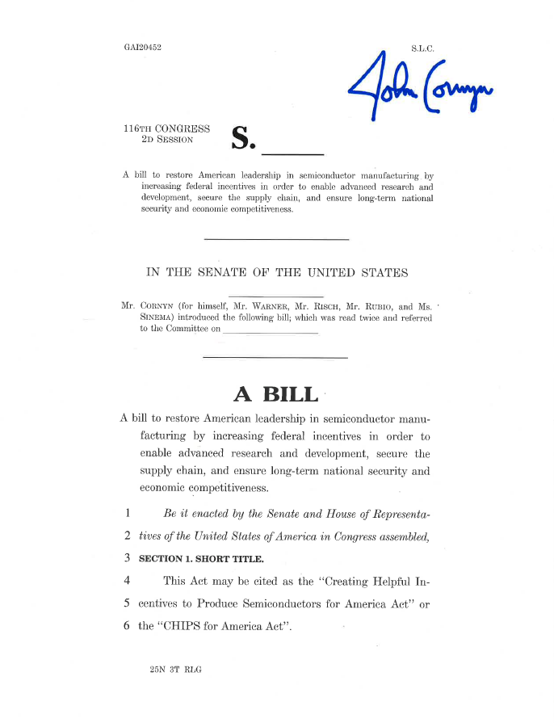
Motivation
“To enable continued advances in computing technologies, a fundamental rethinking is need of the science behind the materials, synthesis and placement technologies, architectures, and algoritms”
(Emphasis added by presenter)
GOAL: Produce a community level report on the basic research needs that align the FES mission to support advanced manufacturing with the CHIPS act call to support semiconductor research at the DOE.
“…A comprehensive and integrative program to accelerate microelectronics research and development at the Department of Energy…”
“Develop plasma-based technologies that enable advanced manufacturing”

Slide 3
CHIPS Act key elements include:
$52.7 billion over five years to incentivize increased U.S. semiconductor manufacturing, R&D and workforce development, including:
$39 billion in grants and loans to attract chipmakers to build, expand, or modernize U.S. facilities and equipment for semiconductor fabrication, assembly, testing, advanced packaging or R&D.
$11 billion to support semiconductor technology and advanced packaging R&D, including a new National Semiconductor Technology Center (NSTC) and a National Advanced Packaging Manufacturing Program.
$200 million for semiconductor education and workforce development
A 25% investment tax credit for U.S. manufacturing of semiconductors and tools to create semiconductors.
$1.5 billion in grants to accelerate U.S. deployments of open standards-based, interoperable 5G infrastructure and more.
Congress also authorized and president signed (but has not yet appropriated) significant increases in federal spending for important science and technology programs including:
$81 billion, 5-year reauthorization for the National Science Foundation (NSF), including more support for basic research and STEM education, and a new $20 billion Directorate for Technology, Innovation, and Partnerships to accelerate domestic development of critical technologies such as semiconductors, artificial intelligence, quantum computing, 6G communications, advanced manufacturing, energy and material science.
$10 billion, 5-year authorization for 20 regional technology hubs established by the Department of Commerce to focus on technology development, job creation and expanding U.S. innovation capacity.
$9 billion, 5-year reauthorization for the National Institute of Standards and Technology (NIST), including direction to advance research and standards development for industries of the future, including quantum information science, artificial intelligence, cybersecurity, advanced communications technologies and semiconductors.
Increased funding authorizations for the Department of Energy’s Office of Science, including programs at the National Labs, and a new $475 million, 5-year authorization for a Microelectronics Research Program and a new $125 million, 5-year authorization for four Microelectronics Science Research Centers.

Slide 4
Formulating the Basic Research Needs Document – “Provide research questions, not research answers”
Meeting held in Bethesda Maryland August 8-9 (in person and online) to identify “Priority Research Opportunities” (PRO’s) and associated key research questions for each PRO. Stake holders from academia, industry, and national laboratory system participated.
Draft report is available for public comment until December 9
Final report to be delivered to the Department of Energy by the end of the year.
Join eMail Group
Workshop Details
Draft Report
Public Comments
What we need from the community in the coming weeks are comments and suggestions on the current draft report. Does the report accurately capture the research challenges for plasma science in semiconductor manufacturing? Does the report make a compelling case for basic research needs in our field?

Slide 5
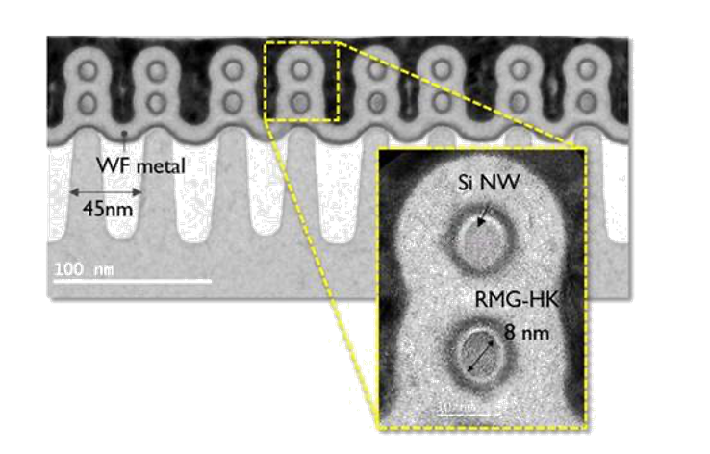
PRO 1: Develop sustainable device manufacturing at extreme scales with integrated efforts in plasma science, reactor technology, process engineering, and plasma chemistry
Motivations:
Continue to provide increased manufacturing capability via plasma assisted manufacturing through the discovery and maturation of new concepts in plasma science
Provide pathways for more sustainable plasma assisted manufacturing technologies that minimize environmental impact
Foster a research environment where new concepts are accelerated to manufacturing through co-design across academia, laboratories, the plasma equipment supply chain, and plasma equipment users
How can plasma-based manufacturing processes support the fabrication of cutting-edge devices while consuming less power and resources, and while eliminating the use and generation of global warming species?
What is the ideal combination of chemistry, charged particle, and photon fluxes for processing materials at extreme scales?
What mechanisms can be employed to generate, control, and monitor plasma generated fluxes in a way that translates to HVM (high volume manufacturing)?
How can plasma-processing support semiconductor fabrication while using less power, fewer scarce resources and minimizing production of global warming by-products?
Can the semiconductor manufacturing technology development paradigm be redesigned to enable cooperative development from the basic science phase to the HVM phase?
Can the supply chain for manufacturing systems be redesigned to reduce or eliminate the decoupled technology advancement efforts between suppliers and equipment users?
Can these shifts be realized through the implementation of efforts similar to those currently in the DOE-FES portfolio such as the INFUSE program, LaserNET, and MagNET?
TEM images of IMEC’s gate-all-around FETs with silicon nanowires of 8 nm in diameter.
Notes:
5
5

Slide 6
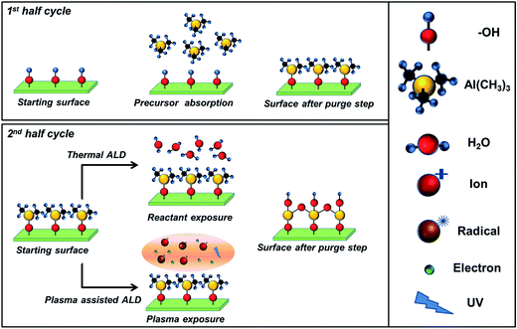
PRO 2: Advance understanding, characterization, and control of plasma-surface interactions down to the atomic scale to enable materials and device structures required for future microelectronics and semiconductor fabrication
Motivations:
Improved process control requires deep fundamental understanding of how plasma generated species interact with materials
Atomic scale processes present a new paradigm with new demands for understanding the fundamental interaction between plasma species and surfaces
How do we independently optimize neutral and ion fluxes for atomic scale plasma-surface interactions?
Are ML and AI applicable and adaptable for controlling, understanding, and optimizing atomic scale plasma processing?
What are mechanisms in plasma-enhanced atomic layer etching (PEALE), plasma–enhanced atomic layer deposition (PEALD), and plasma-enhanced area selective deposition (PEASD)?
Can atomic layer processing be done at lower cost?
Steps in the thermal and plasma assisted (enhanced) ALD for the deposition of Al₂O₃
How do we independently optimize plasma-generated species fluxes and energies at wafer surfaces to control plasma-surface interactions at the atomic scale?
How do we tailor plasmas, wall materials, and wall coatings to achieve precision, repeatability, and manufacturability for future semiconductor manufacturing technologies?
What new plasma processes are needed for emerging materials (e.g., spintronics, ferroelectrics, memory devices)?
How do imperfections (e.g., defects, dopants) get produced in microelectronics-relevant materials when immersed in plasma?
How do we achieve true plasma-enhanced atomic layer etching?
Notes:
6
6

Slide 7
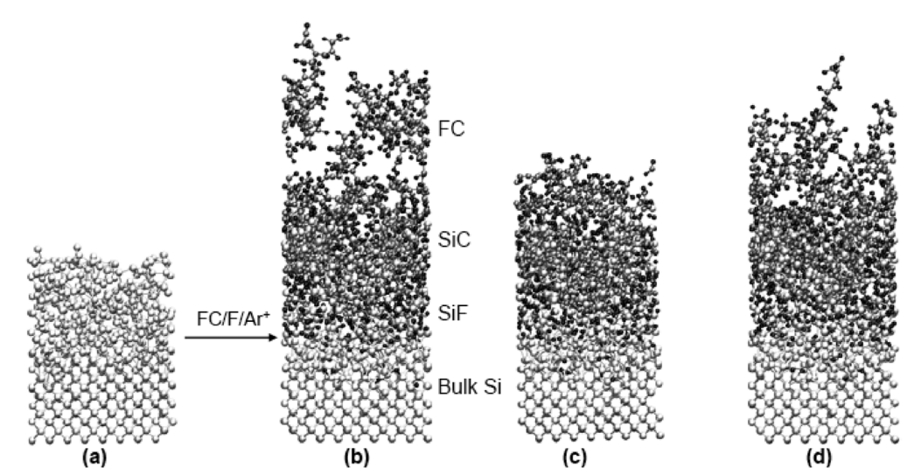
PRO 3: Develop fundamental data and centralized databases to enable comprehensive low temperature plasma diagnostics and modeling
Motivations:
Predictive modelling of plasma systems and fundamental understanding of plasma material interactions require accurate, complete, and accessible databases to quantify interactions between atomic and molecular species
The pace of introduction of new gases and materials to meet the needs of semiconductor manufacturing further expand the demands for accessible datasets
How can cross-sections for electron-impact dissociation of molecules for plasma processing be rapidly measured or computed?
For electron impact collisions, what techniques can determine the energy and angular distribution of reaction byproducts?
Are there approximation methods for rapidly generating such data?
How can plasma diagnostics be used to help generate fundamental data for electron impact collisions on molecules?
How should reliable plasma chemistry mechanisms be developed and tested?
Molecular dynamics modeling results of fluorocarbon neutrals and argon ions
How can the appropriate fundamental data for plasma modeling and diagnostics be rapidly produced to reduce plasma process development time?
Would it be helpful to have a standardized plasma reactor design so measurements made in multiple laboratories can be compared?
How can mechanisms for plasma–surface interactions be developed and tested? What experimental facilities are needed to facilitate development of accurate models?
What data format standards can be developed to enable exchange of data sets and mechanisms?
Is an open-source framework for database management and contributions needed?
How can machine learning enable faster development of reliable mechanisms for plasma chemistry and plasma–surface interaction?
Notes:
7
7

Slide 8
PRO 4: Enable experimentally validated, predictive, and integrated modeling of fundamental plasma physics, chemistry, and surface interactions to enable next generation semiconductor plasma processing
Motivations:
The coupling between power delivery, plasma generated fluxes, and materials present a complex multi-physics science and engineering challenge where modelling and simulation can make great contributions in the acceleration of co-designed plasma manufacturing solutions
The increasing computational speed available to the modelling and simulation community open up additional opportunities where these tools can be used not only for plasma source design, but advanced control and optimization of plasma-based manufacturing systems
What fundamental modeling and experimental validation capabilities, including new plasma diagnostics, are needed to enable predictive modeling of complex transient and multi-step plasma processing to reduce plasma process development time and complexity?
What fundamental modeling and experimental validation capabilities, including new plasma diagnostics, are needed to enable predictive modeling of complex transient and multi-step plasma processing to reduce development time and complexity?
What are the capability gaps in plasma diagnostics and how can they be closed using manufacturing-friendly sensor integration?
Can plasma modeling be used to investigate new reactor configurations and power formats (e.g., magnetic fields, high frequencies, pulsed power, non-linear effects)?
Can plasma modeling be used to investigate new process chemistries and predict their performance on a virtual platform?
What modeling techniques are needed for in-feature engineering?
What are the best strategies for multi-scale modeling (feature to reactor scale)?
What is the role of ML in modeling next-generation plasma process and plasma source design?
How can reduced first-principles models be developed for real-time control of plasma processes?
Particle in Cell (PIC) Simulations of Plasma Processing Reactors
Notes:
8
8

Slide 9
PRO 5: Understand and control low temperature plasma generation of radiation, radiation transport, and materials interactions in semiconductor processing systems
Motivations:
The role of photon radiation in plasma processing is becoming more important for processing at extreme scales, particularly at the atomic scale
The generation of photons via laser-produced plasmas in EUV lithography has further expanded plasma’s contribution in semiconductor manufacturing as well as presented new fundamental science challenges that impact manufacturing capabilities and efficiencies
How can plasma generated photons be used with minimal damage to advance nanofabrication objectives in both advanced lithography and processing?
Is there a more efficient way to create the EUV photons?
How do photons and plasma species interact with the background gas, optical, and plasma facing surfaces in the EUV source and the lithographic scanner?
What happens to Sn and how can it be managed?
How important are photo-generated electrons and holes in promoting etching reactions?
What are other possible mechanisms for photo-assisted etching?
What is (are) the mechanism(s) for photocatalysis in plasma etching?
How important is VUV induced creation of damage and defects?
What are the effects of VUV light on processes at non-wafer plasma-facing surfaces?
SEMs of SiO₂-masked p-Si(100) in an Ar/Cl₂ ICP with added VUV light provided by an Ar ICP. Etching periods: top) 10 min, bottom) 30 min.
Notes:
9
9

Slide 10
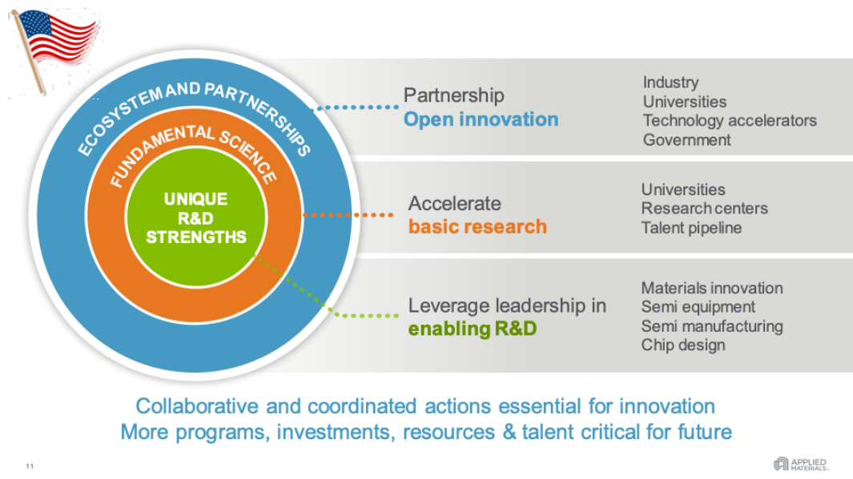
PRO 6: Develop novel institutional structures to meet emerging unprecedented challenges of the field
Motivation: for plasma assisted manufacturing to continue to advance the capabilities of semiconductor manufacturing, research infrastructure and workforce development will need to grow to keep pace with a rapidly growing domestic high technology industry and have that industry remain competitive in the global market
How can we develop new plasma technologies with both fundamental scientific and commercialization challenges while producing a workforce for U.S. industry that is knowledgeable about plasma and their applications?
How can we respond to the unprecedented challenges in plasma science for microelectronics fabrication to develop new technologies in a strongly multidisciplinary field with both fundamental scientific and commercialization challenges?
How can we produce a workforce for U.S. industry that is knowledgeable about plasmas and their applications?
Notes:
10
10

Slide 11
TIMELINE
Public comment period until December 9
Deliver report to DOE by the end of the year.
Sign up for email list to stay up to date on report status
Share link with the community, the more input the better!
Join eMail Group
Workshop Details
Draft Report
Public Comments
Notes:
11
11

